Slide 1




Rural Healthcare AI Bot
Improving Access to Healthcare in Tier 2/3 Regions Using WhatsApp & AI
Subtitles:
Powered by n8n Automation Platform
Team/Organization Name :- Codecrafters
Date :-

Slide 2
Problem Context
The Healthcare Gap in Rural India
80% shortfall in Community Health Centres (CHCs) (Health Dynamics of India Report).
Tier 2/3 towns face :- Doctor shortages. Long travel times to reach hospitals. Overcrowded or understaffed facilities.
Opportunity: 425M+ rural smartphone users with WhatsApp adoption.

Slide 3
Our Solution
-
AI-Enabled WhatsApp Healthcare Bot using n8n
Content :-
An AI-powered chatbot integrated with WhatsApp using n8n.
-
Works on low bandwidth, supports local languages.
Provides :-
First-aid & basic health guidance
Doctor appointment scheduling
Info about nearby government clinics and camps
Referral support and emergency help
-

Slide 4





How It Works
Seamless Patient Experience via WhatsApp
WhatsApp
AI Bot
Teleconsultation
Bot shares
Symptom check
Care guidance
Doctor connect option
User sends message on WhatsApp (e.g., “I have a fever”)
Despite being red, Mars is actually a cold place.
It’s full of iron oxide dust
Nearby clinic/hospital info
Health camp schedules
Emergency help

Slide 5
Technical Architecture
35%
30%
20%
n8n + AI + WhatsApp = Scalable Rural Health Solution
Key Tech Stack:-
n8n
Enables message handling, automation, and WhatsApp API connection.
AI NLP Model
Understands user input, identifies symptoms, and processes natural language.
External APIs
Provides real-time access to healthcare facility data and resources.
15%
Local Language Support
Ensures accessibility for diverse user groups in Tier 2/3 regions.

Slide 6


Impact & Future Roadmap
Impact Goals :-
Real Impact. Real People. Real Potential.
Reduce patient wait times & travel by 30%
Offer 24/7 guidance to non-emergency cases
Help rural population make informed decisions faster
Future Additions :-
Integrate with Ayushman Bharat Health Account (ABHA)
Add voice-based support
Offline support via SMS fallback
AI model fine-tuning for hyperlocal symptoms

Slide 7
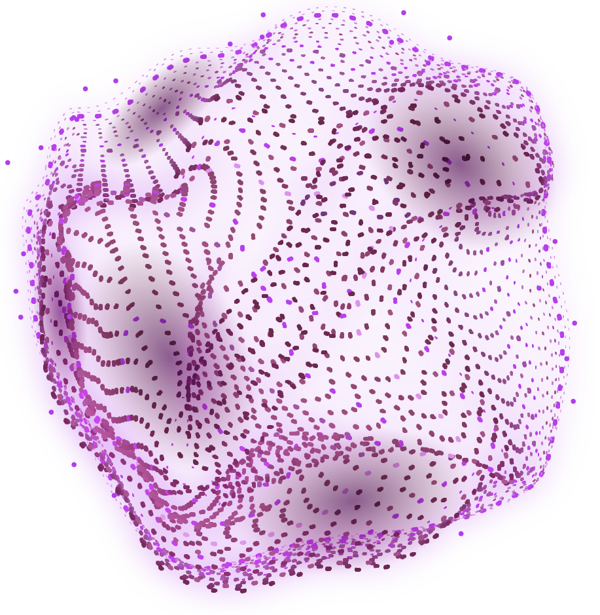
AWESOME WORDS

